Slide 1
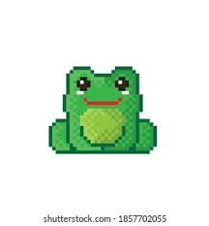
Knit It
A frog catch game

Slide 2
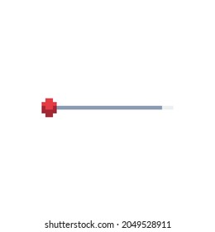
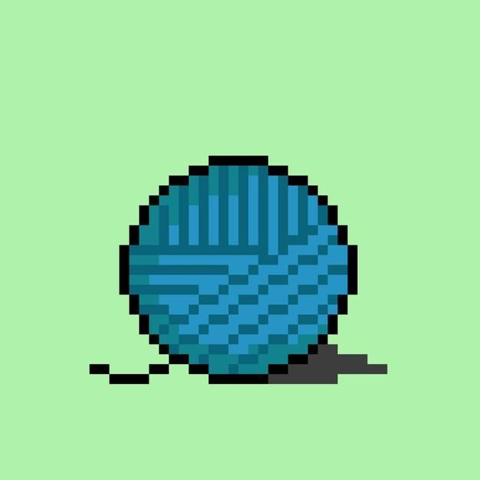
Pitch
Knit It, is a cute simple game that follows a frog as he is trying to knit his jumpers.
The game appeals to all with its cute pixel graphics- help the frog catch his required colours of yarn in order to knit himself a new sweater to keep warm.

Slide 3
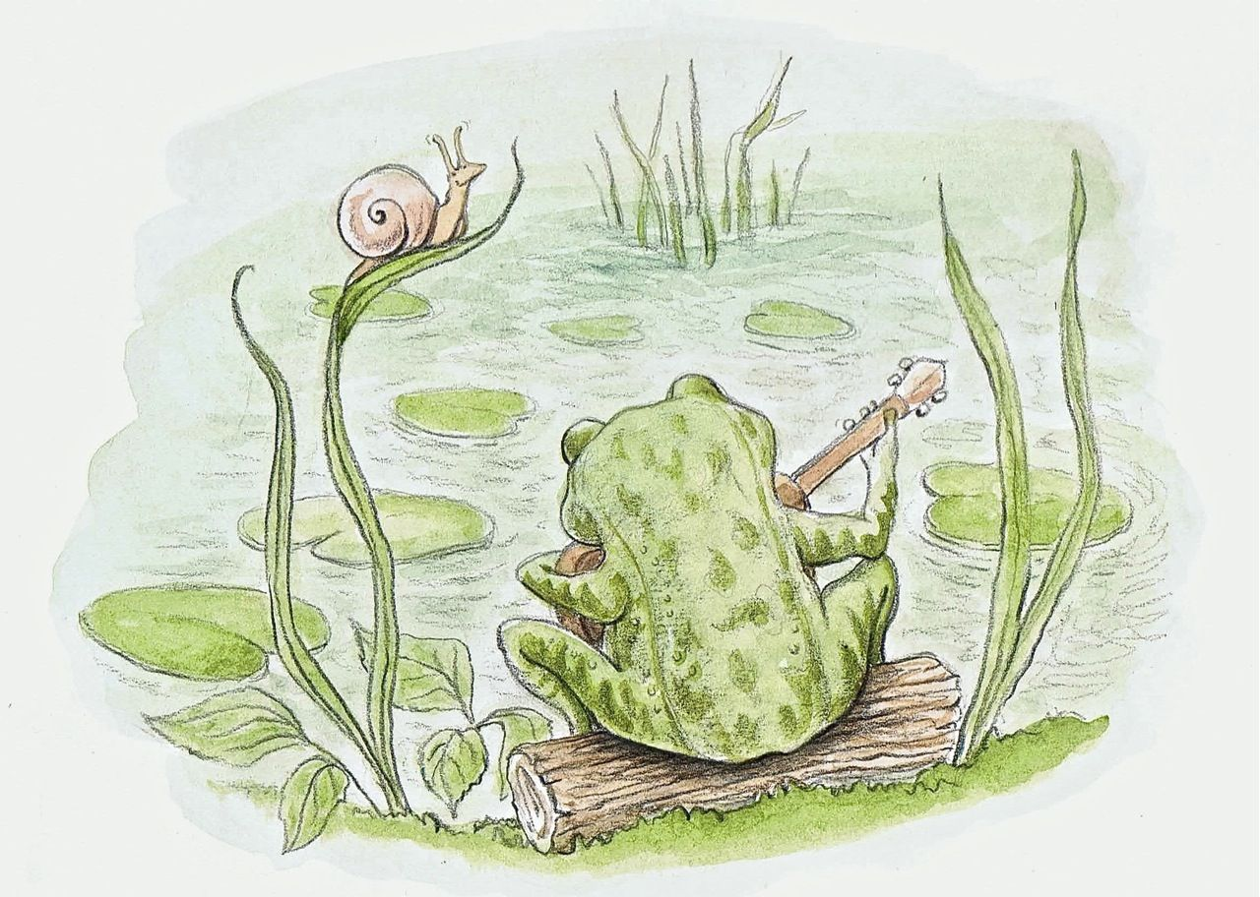

World Background
Sponge is a casual swamp frog who has a love for knitting. It is his goal to knit the greatest jumpers.
He has been catching and combining yarn in order to find the best combination for a jumper.
He sells his jumpers in order to buy books to fuel his desire to knit and create more jumpers.

Slide 4
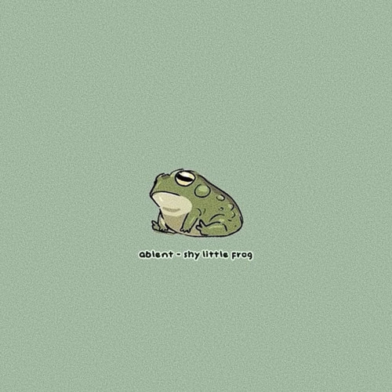

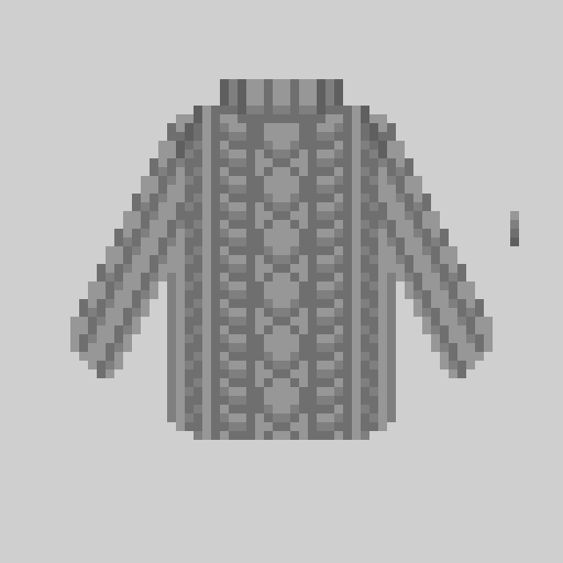
Pillars
75% Catch game
10% customisation
10% Energy recharge waiting system,
5 % Cute Music

Slide 5
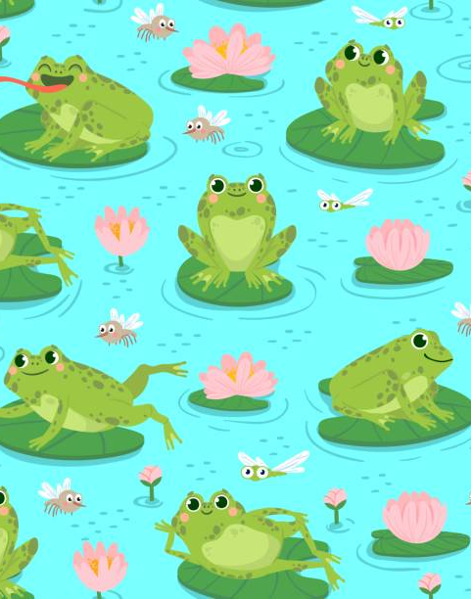
30 second Game Play:
game consists of a frog on a lily pad catching balls of certain coloured yarns to create a
knittied sweater while trying to collect a certain colour of yarn you must push "sponge" (the frog)
away from getting hit with sowing needles.You have certain time to collect the yarn to knit your jumper.
Once you have collected all of you yarn and havent died from getting hit with needles you can see your jumper
on sponge with all colors of yarn collected on the game.

Slide 6
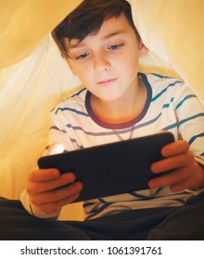
Market Analysis:
expected addiunce of the game is children under the age of 16 and older indivduals . we expect to make money from the adds on the main screen before entering game as
people buying the coins as in-app purchases. Expected money made 50,000.

Slide 7
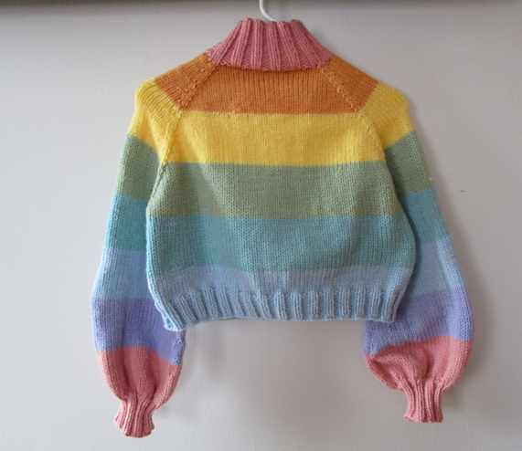
Features:
Every 20 minute you get one life but can only get five at one time.
every level you sussesfuly win you get coins you can buy others sweeter that the have made after every level.
when you have coin you can also purchase other yarns which create different patterns with in the jumpers you knit.
you can also save you frog sponges life in a game if you have ten coins.

